Slide 1
OFDM PAPR Reduction through PTS technique

Slide 2
Table of contents
The PAPR problem in OFDM
Theory
PAPR reduction techniques
The PTS technique
PTS simulations
Incorporation into the OFDM modem

Slide 3
The PAPR problem in OFDM

Slide 4
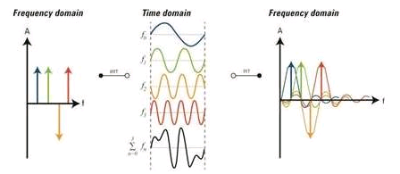
Background- OFDM
The principle: transmission of a signal that is a linear combination of an orthogonal basis
The symbols are the linear combination’s coefficients and are statistically independent:

Slide 5
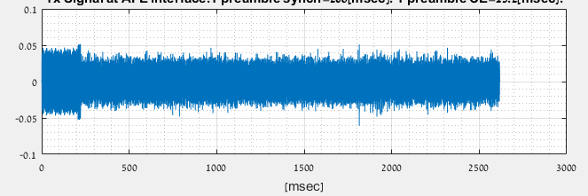
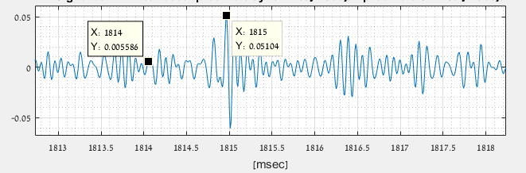
Background- OFDM
Time domain signal:
Typical shape

Slide 6
Motivation: PA linearity

Slide 7
Theory

Slide 8
PAPR definition

Slide 9
PAPR distribution (CCDF) [1]
Central limit theorem:
Magnitude is Rayleigh distributed:
Hence;

Slide 10
PAPR distribution (CCDF)
Probability of at least 1 sample of time domain signal to cross a certain power level:
if we define , then;

Slide 11
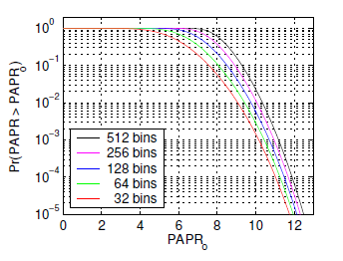
PAPR distribution (CCDF) [1]
Theoretical curves

Slide 12
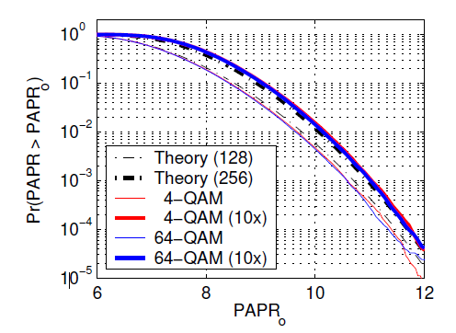
PAPR distribution –Interpolation [1]
Analog signal can be modeled by an interpolated digital signal
Interpolated digital signal has no longer uncorrelated samples
An interpolated N-samples symbol has effectively the non-interpolated PAPR of a 2N-samples symbol

Slide 13
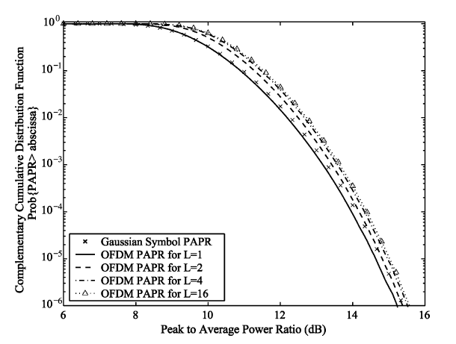
PAPR distribution -Interpolation
The effect of increasing the interpolation factor attains a limit
Typically, a value of L=4 is sufficient

Slide 14
PAPR dependencies
Modulation
Number of carriers
Sampling rate?
Interpolation to approach the analog signal

Slide 15
PAPR reduction techniques

Slide 16
Criteria
PAPR reduction
BER performance
Average power conservation
Data Rate
Spectral spillage
Complexity

Slide 17
Techniques comparison
Technique | PAPR Reduction | BER performance | Average power Conservation | Data Rate Loss | Spectral Spillage | Complexity
Clipping | 3dB | Low | Yes | None | Yes | Low
Coding | 3dB | Medium | Yes | Medium | No | Low
Companding | 6dB | Medium | No | None | Yes | Low
Tone Reservation | 3dB | Medium | No | High | No | High
PTS/SLM | 3dB | High | Yes | Medium | No | High

Slide 18
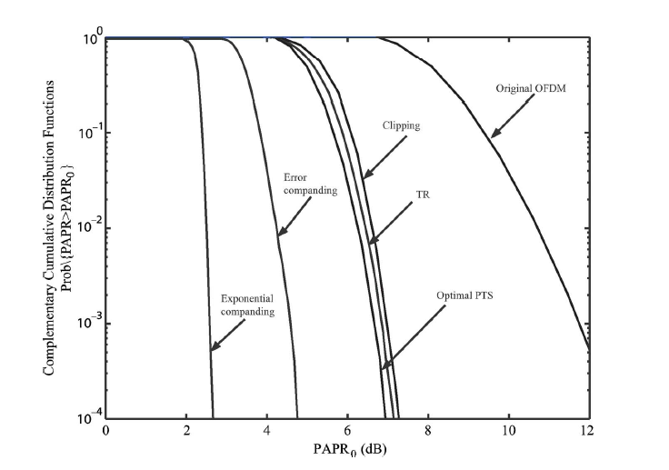
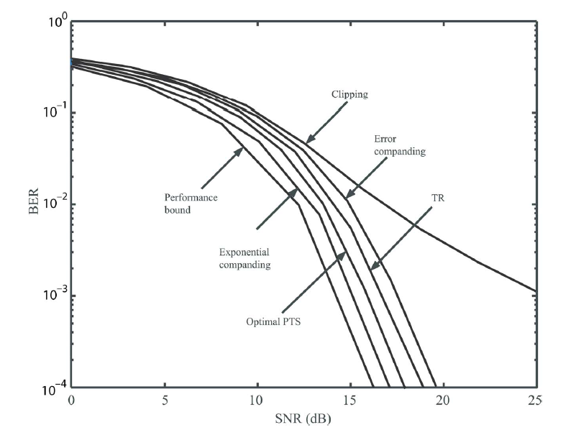
Techniques comparison
Most literature ([4], [5] ,[6] and others) claims the SLM/PTS technique
tradeoffs best the different performance criteria

Slide 19
The Partial Transmit Sequence (PTS) Technique

Slide 20
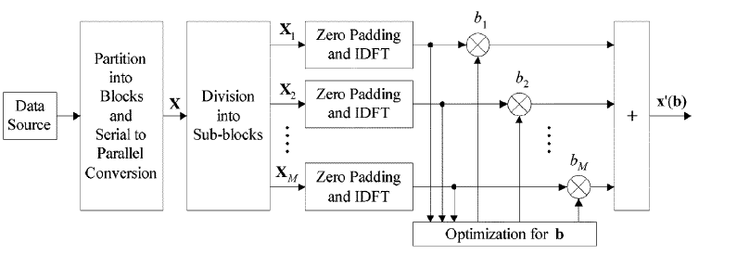
PTS- Block Diagram

Slide 21
Algorithm steps
Division of the N-long OFDM symbol into M sub-blocks:
Contiguous
Polyphase
Zero padding of each of the sub-blocks to length of N
IDFT over each of the sub-blocks
Calculation of optimum PTS coefficients vector:
Iterative flipping
Reduced complexity
Multiplication of the sub-blocks by the PTS coefficients
Summation of the sub-blocks

Slide 22
Mathematical development
Frequency domain OFDM symbol vector form:
Division into M disjoint sub-blocks:
Zero padding of sub-blocks such that:
IDFT execution:

Slide 23
Mathematical development
Multiplication by PTS coefficients:
Summation:

Slide 24
Calculation of PTS coefficients
Optimum PTS: for every symbol, one needs to scan all possible combinations of the M coefficients and all possible values of those coefficients- impractical
In practice:
Number of values limited to W.
Typical values:
W=4
M=8
Typical values of PTS coefficients:
Example
Sub-optimal low complexity scanning algorithms

Slide 25
Calculation of PTS coefficients- Iterative flipping [7]
b1=1
bm=1 for all m
Compute PAPR. This will be the reference PAPR
Change b2 across all possible W values:
compute PAPR for each value
Keep the value that brought to minimum PAPR as reference
Repeat step 2 for m=3,…,M-1

Slide 26
Simulation

Slide 27
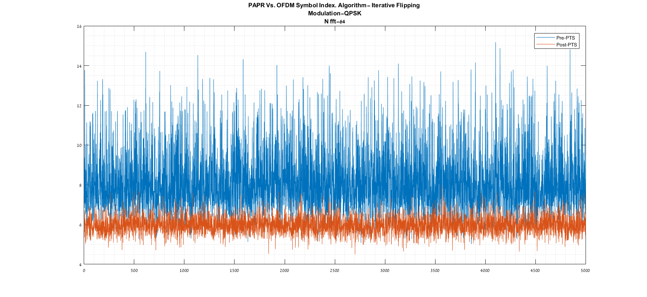
Simulation (time domain)

Slide 28
Simulation (EVM)

Slide 29
Calculation of PTS coefficients- Reduced Complexity [4]
It is to provide very close performance in terms of PAPR reduction wrt the ideal PTS, yet with reduced complexity
Based on gradient descent search algorithm useful in combinatorial optimization problems suggested by Aarts & Lenstra
Principle: Find gradient and optimum step simultaneously, by running over the r-distant b vectors from an initial guess. Repeat that I times

Slide 30
Calculation of PTS coefficients- Reduced Complexity [4]
i=1
b_initial=ones(M,1). b_opt=b_initial
Run over all M-long b vectors r-Hamming away from b_opt, assign all W^r possible values and compute PAPR
Save b_opt; the one bringing to minimum the PAPR
If i<I: Increase i by 1 and return to step 3. else - terminate

Slide 31
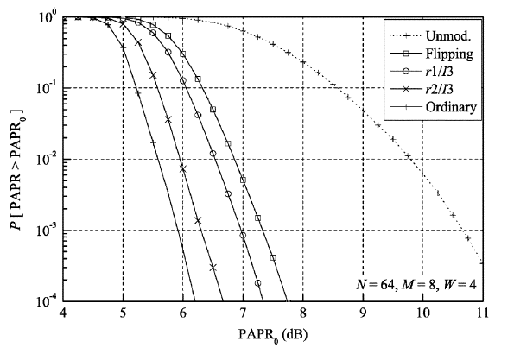
Expected results (vs. unmodulated, vs. ideal)

Slide 32
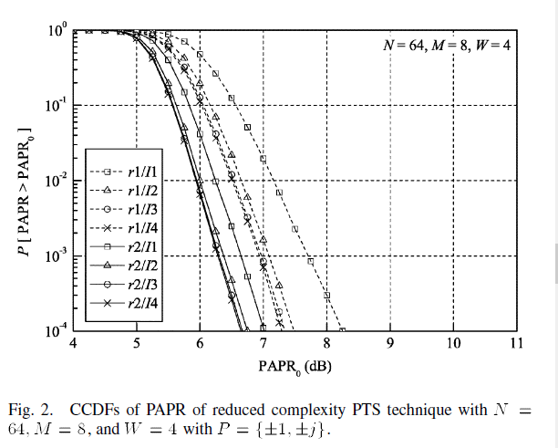
Chosen set of parameters (r,I)

Slide 33
Simulation Vs. Article

Slide 34
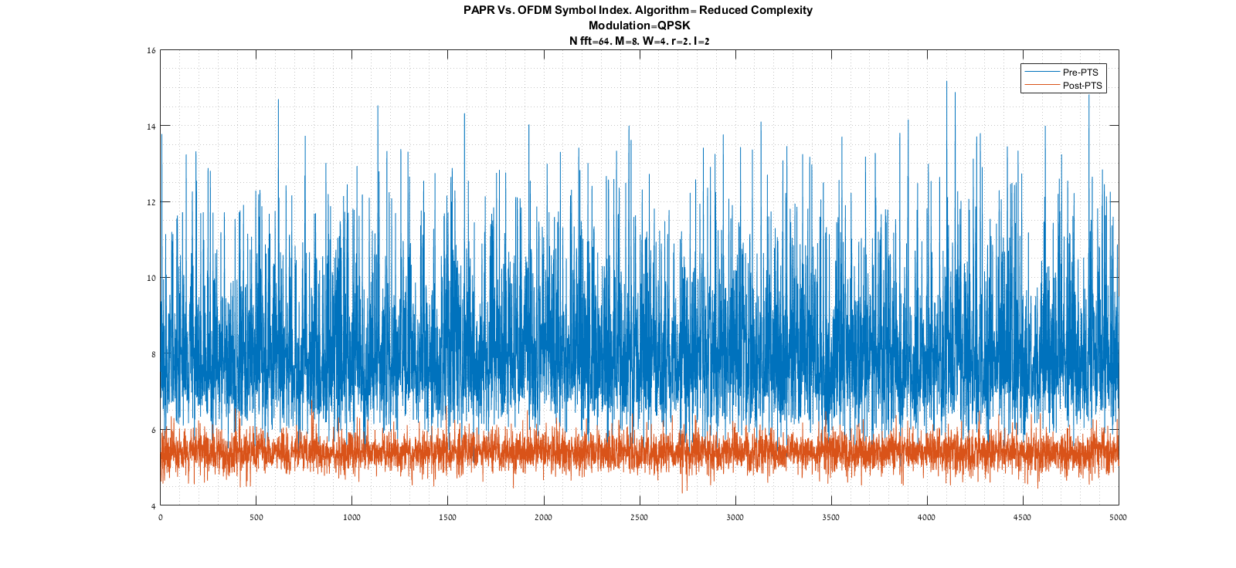
Simulation- time domain
Notes:
The peak power is the absolute one

Slide 35
Calculation of PTS coefficients- Complexity for every OFDM symbol
Reduced Complexity algorithm: at every i<=I
We run over r choose M-1 different r-Hamming distant b vectors
For every vector, we try W^r different values for the r different terms
Conclusion:
Iterative flipping algorithm:
Example: I=1, M=8, W=4, r=2
Reduced complexity: 336 steps
Iterative flipping: 28 steps

Slide 36
Reduced complexity Vs. Iterative flipping

Slide 37
Incorporation into the OFDM modem

Slide 38
Difference between article and effective signal
Guard bands & DC
pilots

Slide 39
CCDF

Slide 40
spectrum

Slide 41
time

Slide 42
EVM

Slide 43
Scrambling method
Contiguous
scrambled

Slide 44
References
Circuit-Aware System Design Techniques for Wireless Communication, by Everest Wang Huang
OFDM for wireless communication systems, Prasad
An Overview: Peak-to-Average Power Ratio Reduction Techniques for OFDM Signals, Jiang& Wu
PAPR Reduction of OFDM Signals Using a Reduced Complexity PTS Technique, Hee Han & Hong Lee
peak to average power ration in OFDM, Chapter 3. Shodhganga
PAPR Reduction Techniques for OFDM Systems, P.Kalaivani, ,S.R.Balasubramanian,
Peak to average power ratio reduction of an OFDM signal using PTS, Cimini, Solenberger

